Slide 1
Front Cover Title 2
BSc (Hons) Nursing
Pre-registration Nursing Programme
Margaret Crowley . NHSGGC
School of Health, Wellbeing and Social Care
December 2024 – January 2025

Slide 2

Outline of Session
Part 1
Open University Nursing Degree
Part 2
Entry requirements and application process
Notes:
The presentation covers the following points

Slide 3

About The Open University
Our mission is…
To be open to people, places, methods and ideas
Our vision is…
To provide life-changing learning that enriches society
Our values…
Inclusive, innovative and responsive.
Through learning we aim to transform lives and communities, opening a world of possibilities for everyone
Notes:
LEARN AND LIVE THE OPEN UNIVERSITY’S STRATEGY FOR 2022-2027 (Learn and Live, The Open University’s Strategy for 2022-2027)
OUR ENDURING MISSION: Open to people, places, methods and ideas
OUR VISION: Life-changing learning that enriches society
THE VALUES WE LIVE: Inclusive, innovative, responsive Through the power of learning we aim to transform lives and communities, opening a world of possibilities for everyone.

Slide 4
Nursing degrees
4 year part-time programme delivered in partnership with your employer
Prepare students for entry to the NMC register
  Adult
  Children and Young People
  Learning Disability
  Mental Health
Provides students with knowledge, skills and contemporary clinical practice experiences for their future careers
  50% theory, 50% practice
Student remains employed in HCSW role
  Must be substantive post
  Must be minimum of 26 hrs per week
  Supernumerary status as student nurse
One intake per year - October

Slide 5
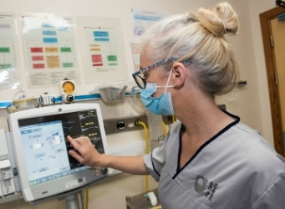
Our BSc (Hons) Nursing Students
Work in a healthcare support role and have the support of their employer
Have the potential and values to succeed as a nurse
Meet the NMC requirements for entry to nurse education
Have a strong personal commitment to their development of knowledge, skills and attributes
Study with students from a diverse range of backgrounds
Notes:
Discuss care home and if not in traditional HCSW role
ENSU
RE STUDY LEAVE HIGHLIGHTED AT THIS STAGE
Study in early stages with social work students, healthcare practice students, service users and graduate nurses – 4 nations, but directed to relevant Scottish materials – e.g., policy / legislation etc.

Slide 6


Developing graduate nurse qualities
Compassionate, caring and promotes dignity
Upholds professional values
Critical, analytical and creative thinker
Committed to empowering service users
Evidence-based decision maker
Committed to inter-professional working
Leader of people and resources
Manages change and innovates in practice
Independent learner
Committed to lifelong learning

Slide 7
BSc (Hons) Nursing Degree Overview
Level 1 (16 months) | Level 2 (16 months) | Level 3 (16 months)
Introduction to health and social care K102 (60 credits) 600 hrs of theory | Understanding nursing: knowledge and theory K210 (60 credits) 685 hrs of theory | Assimilating nursing: knowledge and theory K325 (60 credits) 685 hrs of theory
Introduction to healthcare practice K104 (60 credits) 170 hrs of theory 770 hrs of practice 3 x practice placements | Developing nursing practice K211 (60 credits) 85 hrs of theory 770 hrs of practice - 3 x practice placements | Becoming an autonomous practitioner (60 credits) K326 Adult K329 Children and Young People K328 Learning Disability K327 Mental Health 85 hrs of theory 770 hrs of practice - 3 x practice placements
Future Nurse Degree Overview
Notes:
Modules across each stage enable learners and their managers to focus on areas that are most relevant to their workplace and specific role.
Study and practice focus is field specific from registration.
Incrementally build knowledge and skills – themes based on NMC standards and competencies
The final module in level 3 determines the field of practice at point of exit. (becoming an autonomous practitioner – registration in field)
Learning materials are shared across all four fields of practice.
Emphasis on application of theory to own field of practice.
Shared learning experiences through mixed 'Tutor Groups’
Modules studied concurrently in level 1 core modules covering theory and practice setting the foundations for further study.
Levels two and three: 2 x 60 credit modules at each level, increasing depth and breadth of exposure to own and other three fields of practice.

Slide 8
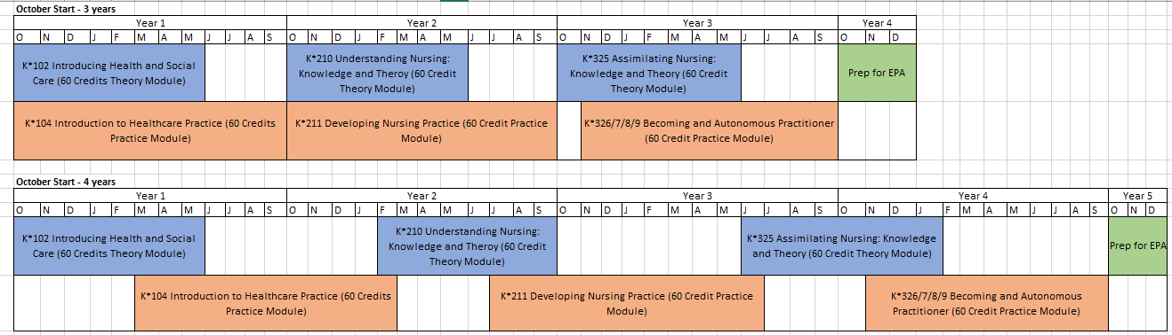
BSc (Hons) Nursing: 4 year plan
Level 1 – 16 months Level 2 – 16 months Level 3 – 16months
Notes:
This slide provides you with a timeline for delivery of the programme. The blue blocks represent the theory component and the salmon colour represents the practice modules.

Slide 9
Programme delivery and assessment
Theory:
Tutor supported, online learning:
Books and eBooks Interactive and reflective activities
Rich media (videos/animations) Online tutorials Forum discussions/activities OU Anywhere App
Practice:
Practice tutor supported placement
Placement experiences arranged: practice learning pathways link theory to practice
Enquiry based learning: competent, reflective, autonomous practitioners group-based teaching approach
Ongoing Assessments
Theory
TMA (Tutor Marked Assessment) iCMA (Interactive Computer Marked Assessment) EMA (End of Module Assessment)
Practice
Ongoing assessment using PAD (Practice Assessment Document) PAI (Practice Assessment Interview)
Notes:
Face to face induction will be locally held and hosted
Online tutorials -essential element of learning delivery in the new curriculum: in small groups (based on new EBL teaching and learning approach)
Opportunity for individual time with practice tutors
Enquiry based learning: OU Future Nurse Teaching and Learning Approach
Based on student active participation, Enquiry Based Learning (EBL) is a student-centred teaching approach that motivates and engages students with direct decision making, applied analytical thinking and results in competent, reflective, autonomous practitioners, able to think critically, problem solve and respond in a fast paced health environment.
Through a practice-based lens, EBL moves learning to knowledge acquisition and synthesis. EBL requires the student to take a holistic approach of the whole person in context rather than the medical model of illness, integrating knowledge with care and closing the practice -theory gap.
Enquiry Based Learning (EBL) takes an active participation approach that motivates students with direct decision making and applied analytical thinking
bridges the practice-theory gap using teaching strategies that requires the student to research and enquire, relate and explain theoretical knowledge to their practice.
guides students to be competent, reflective, autonomous practitioners, able to think critically, problem solve and respond in a fast paced health environment.
constructs learning and knowledge that is contextual, participatory and collaborative emphasising active and cooperative participatory learning.
is a group-based teaching approach which promotes student learning that is practical, negotiated and allows the student to develop themselves as future nurse leaders.

Slide 10
Practice Learning Pathways (PLPs)
Provide three practice learning experiences in each level:
- two complimentary (outside of own work area)
- one base placement
Learning for practice and learning in practice integrated throughout the programme
770 practice hours completed at each level
Ensure students meet NMC requirements
Base placement will be at the end of each level

Slide 11
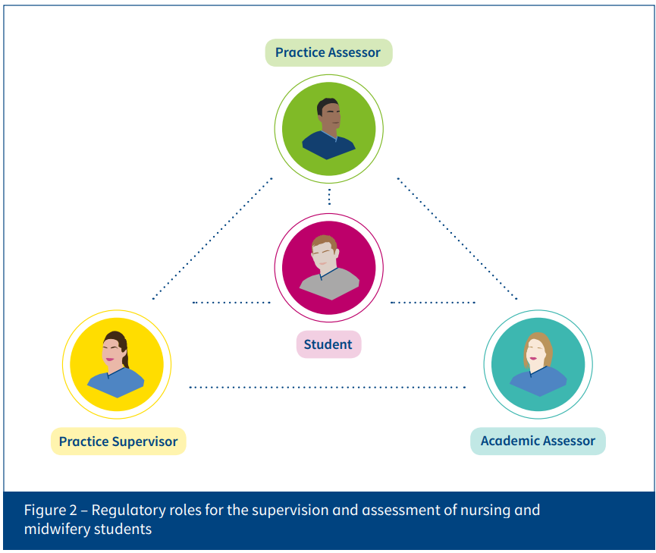
Practice Based Learning Support
Practice Assessor
Feedback from practice supervisors
May observe students
Gather evidence from other sources
Communicate and collaborate with academic assessor
Make / record objective, evidence-based assessments
  conduct, proficiency achievement
Academic Assessor
Gather evidence from other sources e.g., practice supervisor observations
Communicate and collaborate with practice assessors
Make / record objective, evidence-based assessments
  conduct, proficiency, achievement
In partnership with the practice assessor, make recommendations for progression for a part of the programme
Practice Supervisor
Role Model
Support and supervise
Provide feedback
Record observations
Contribute to assessments
Raise and respond to student conduct and competence concerns
Engage with practice assessor / academic assessor
Notes:
Make and record decisions on achievement, proficiency and conduct based on multiple sources of evidence
Communicate and collaborate with academic assessors to agree student progression and proficiency
- these are the same in both sections, can they be added in one section – or add a 4th “row” with both PA and PT/AA combined if that makes sense??
SLIDE NOTES TEXT:
Run through the three roles and explain how this works
Terminology reflects NMC
You could explain your own role and how this might look if that helps context for employer

Slide 12
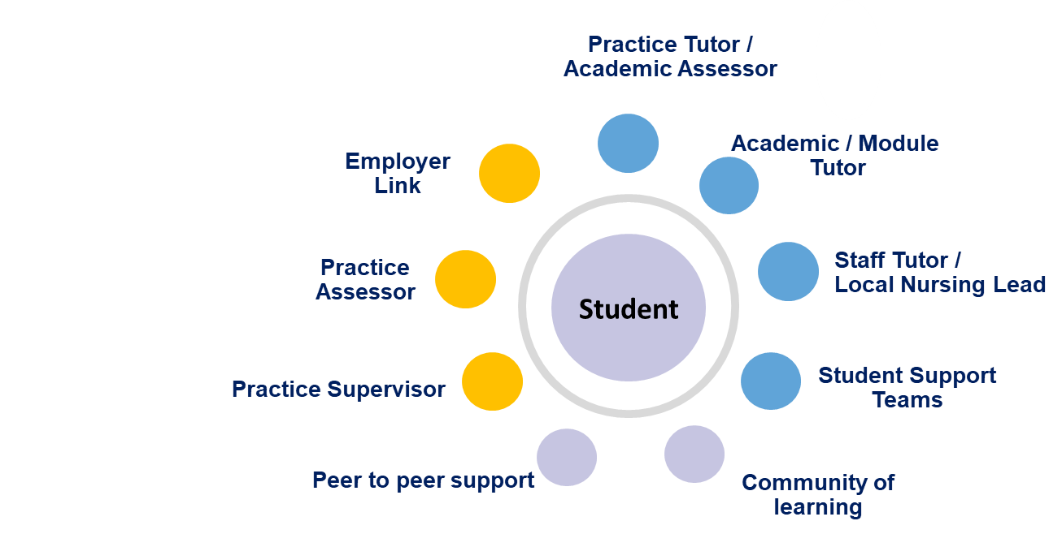
Supporting student success
Further support
Library IT Helpdesk Student Home Student Support Team Module Teams

Slide 13
Entry requirements for BSc (Hons) Nursing
Requirement | Demonstrated by:
Numeracy | Core skills in Numeracy at SCQF level 5 or Standard Grade Mathematics or Arithmetic (pass at credit level) or N5 in Mathematics or Arithmetic or the equivalent
Literacy | Core skills in Communication at SCQF level 5 or Standard Grade English (pass at credit level) or National 5 in English or the equivalent Students who have achieved K101 or K102 will meet required literacy
IT Literacy | Computer skills
Meet OU requirements to enable declaration of health and character on registration with NMC | Satisfactory References, Occupational Health review and PVG
Candidates must provide evidence of completed qualifications with their application – SQA or other relevant Certificate(s)
Notes:
For those who aren’t sure whether or not they have numeracy and literacy at the required level, they can set up an online account with MY SQA (hyperlink in slide and following slides with screenshots). They can set it up quickly with their SCN number (this can be found on certificates) and their email address. If they don’t have their SCN, they can contact SQA and they may be able to trace them by their address/previous address and D.O.B.

Slide 14
SCQF Level 5 Information: See SCQF - SQA
SCQF Level 5
  Nat 5 (A-C)
  Intermediate 2 (A-C)
  Credit Standard Grade (Grade 1 or 2)
  ‘O’ Grade A-C
You will need to include a scanned copy or photograph of your original certificate with your application for the degree programme
If unable to find this, check your qualifications by setting up an online account with MYSQA (1995 onwards)
If unable to access your qualifications (pre-1995) contact SQA for advice

Slide 15
Qualification check: Lost/damaged certificates (Scotland)
Studied before 1995 | Studied after 1995 (*core skills from 1999)
MySQA (next slide) not available pre 1995 Order a replacement certificate* : Fee payable £40 (at 20.05.24) 15 working day turnaround (usually) SQA - Certification Services Consider “Subject Access Request”: Personal information - SQA (new) Complete Literacy and/or Numeracy at SCQF L5 or above (if necessary) | Check MySQA for Literacy and Numeracy – both must be at SCQF L5 or above Core skills profile* accepted – check both components in each are at L5 (previous slide) If you have both Q’s at L5, order a replacement certificate* (see pre-1995 information) MySQA screenshot is not acceptable If required, complete Literacy and/or Numeracy ASAP – SQA certificate issued when achieved (free)
NOTE: Certificated evidence of Literacy and Numeracy must be submitted by the application deadline otherwise your application will not be processed.

Slide 16
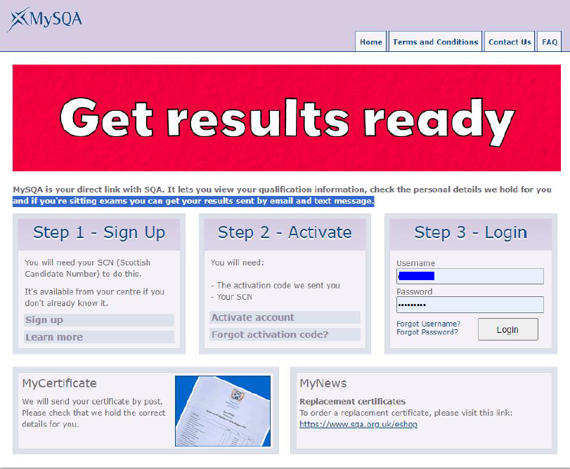
Setting up “MySQA”
Sign Up (mysqa.org.uk)
If you don’t know your “SCN” (Scottish Candidate Number), contact the SQA who will provide this.

Slide 17
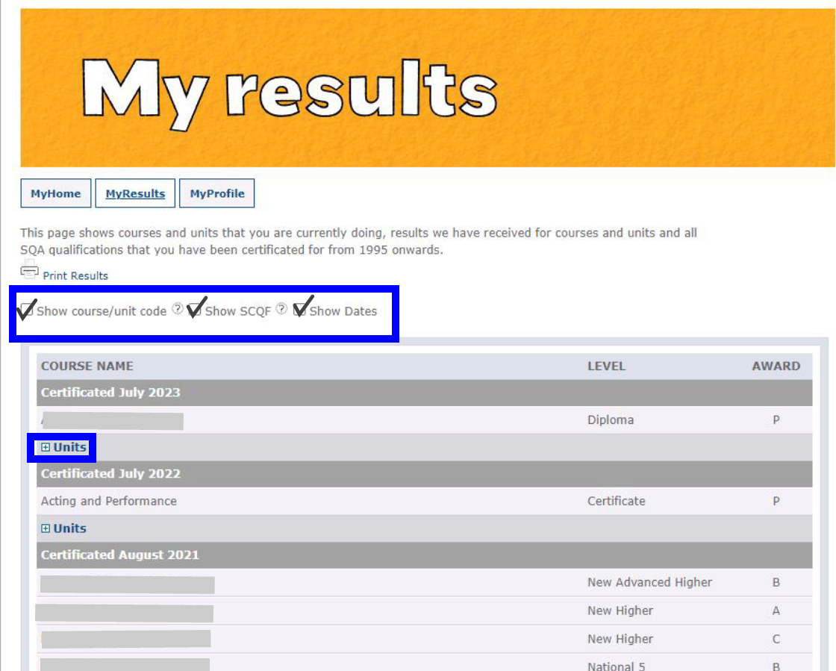
“MySQA” Account
Checklist:
Show course / unit code
Show SCQF
Show dates
Click the + sign to show all units studied
Please note this is not accepted as evidence of achievement.
It lets you check the subjects and levels achieved.

Slide 18
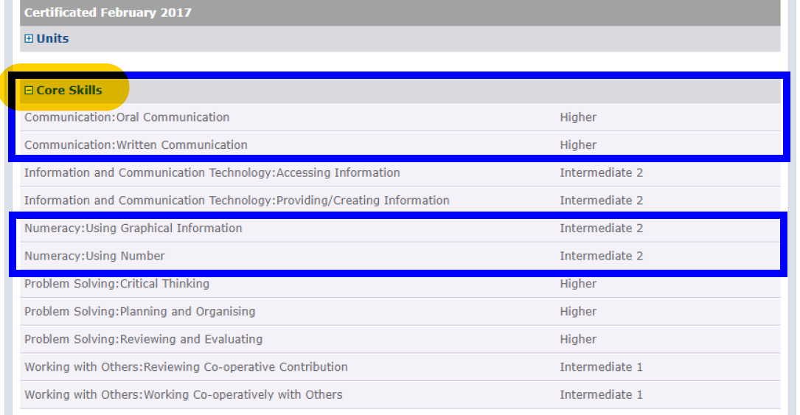
“MySQA” Account
Communication:
Both must be at SCQF L5 or above
Numeracy:
Both must be at SCQF L5 or above

Slide 19
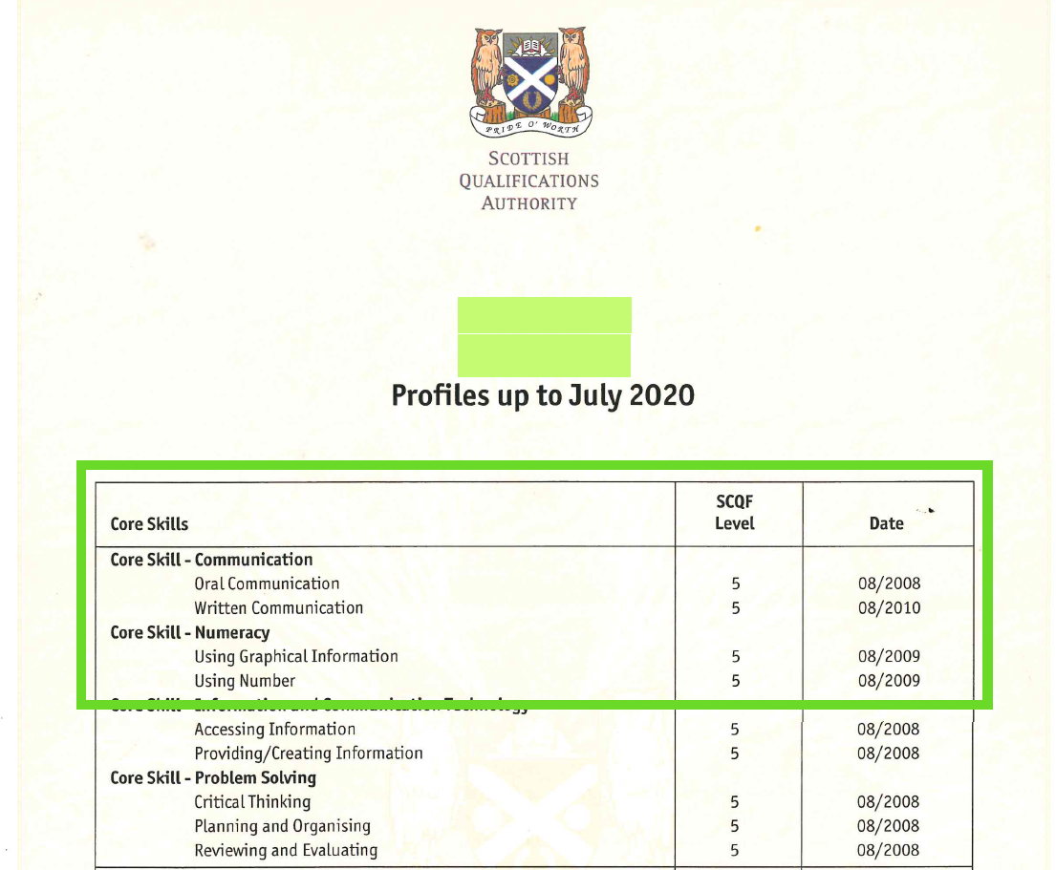
Core Skills Profile
If you studied other qualifications accredited by the SQA after 1999, you should have a “Core Skills Profile” (contact SQA if unsure)
You must have both components at SCQF L5 or above for each of the following Core Skills:
Core Skill – Communication
  Oral Communication
  Written Communication
Core skill – Numeracy
  Using graphical information
  Using number
LEVEL 5 or above
Note: We are unable to advise on other qualifications, e.g., degrees or non-healthcare related HNCs (Details for queries at the end)

Slide 20
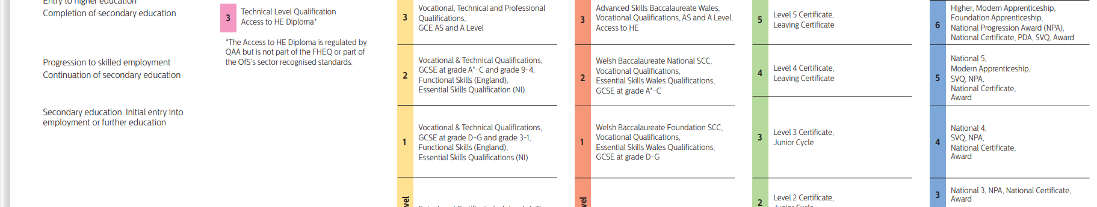
Studied in England, Ireland or Wales?
Qualifications can Cross Boundaries: A guide to comparing qualifications in the UK and Ireland (qaa.ac.uk)
Are your qualifications in line with SCQF L5 or above?
If not, you must achieve the relevant qualifications at L5 prior to the application closing date

Slide 21

Studied outside the UK?
You will need to obtain a “Statement Of Comparability”
This service:
Is available on the “ENIC” website: Statement of Comparability (enic.org.uk)
Provides evidence of the level of your overseas qualification
Obtaining your statement of comparability:
Create your account, log in and upload documents
Cost £49.50 + VAT* (if applicable) plus delivery charge (at 19.11.24)
Frequently asked questions FAQs (enic.org.uk)

Slide 22
If you don’t meet the Numeracy requirements
Achieved by studying an SQA accredited N5 Numeracy course at college:
Code F3G F11* or H225 75
Approx. 40 hours to complete
Cost £110-£150, Part Time Fee Grant may apply (Earnings under £25K)
Fixed or flexible start dates, must complete by OU application deadline
The following colleges currently offer online numeracy*:
  Dumfries & Galloway Numeracy @ SCQF Level 5 | Dumfries & Galloway College (dumgal.ac.uk)​
  Fife College: Contact for latest information – Tel: 03442 480115/ info@fife.ac.uk
  Dundee & Angus Mathematics and Numeracy (Distance Learning) (dundeeandangus.ac.uk)
  NHSGGC – has an SVQ centre where you can complete Numeracy and Literacy Core skills – please contact Zita Mc Naught on Zita.McNaught@nhs.scot to discuss further
  Other colleges may offer free courses for local residents – check!

Slide 23
If you don’t meet the Literacy requirements
K102
Introduction to Health & Social Care
Numeracy SCQF level 5
Eligible to apply to BSc (Hons) Nursing
OR
Literature 1 (SCQF L6)
Literature 1 @ SCQF Level 6 | Dumfries & Galloway College (dumgal.ac.uk)
(£200 at 19.11.24)
Eligible to apply to stage 1 of BSc (Hons) Nursing. If successful application process, students only study the practice-based module in stage 1 (K104) as they will have already studied K102

Slide 24
Credit migration of previous OU study
  Subject to successful application, students who complete:
    K101 or K102 as a standalone module register in Oct 2025 and start the practice module (K104) in March 2026
    K102 and K104 as part of the Certificate in Healthcare Practice can articulate directly into level 2
  Students will be required to apply for credit transfer if previous learning has been delivered by another provider.
Notes:
Students transition arrangements are as follows
All students will complete the OU APEL document to confirm the hrs and employer will confirm that hrs have been completed (this text could into the notes for presenter )
Student currently studying for the Certificate of Higher Education in Health Care Practice (T01) – will have to complete the additional hrs as noted above -same process
K105 Meeting transitioning requirements for Future Nurse level 1 -170 hrs

Slide 25
Next steps
  Find out more about the OU nursing programme:
  Explore the OU nursing website - Nursing | Open University in Scotland
    Talk to current OU nursing degree students
  Speak to your line manager to get their support for your application
  Notify the employer link of your application
  Register your interest via Scotland Nursing Enquiry Form and receive an application pack from March 2025
  Applications will open on 24th March 2025 and close on 6th June 2025
Notes:
Resources for managers –employer pack
Narrated powerpoint with information on how to complete the application form, personal statement and discussion task will be sent to you with application pack
Applicants must be employed in healthcare settings, with appropriate support from registered nurses. Prior to applying arrangements should be in place to ensure that the required range of practice experiences can be delivered by the employer or in partnership with other local employers. Practice settings need to be educationally quality assured.
Our entry requirements reflect the OU ethos of being open to people, who may not otherwise have the opportunity to enter a nursing programme due to educational entry requirements of other providers. The OU offers support to enable students to develop academic skills to support their studies.
English and Maths: Values-based selection and interview
Criminal record and occupational health clearance and acceptable references.
Supported by employer.
A practice environment where practice supervision and practice assessment is available in line with the New NMC (2018) Standards for pre-registration nursing education.
Nursing Associate
We highly recommend that students gain their Maths and English qualifications before embarking on the nursing programme, but can be considered without.
Students will need to gain evidence that they have passed the course, so they need to be aware of this when siging up and ensure that they will get a certificate to demonstrate their achievement. Must be achieved by end of programme.
Same recruitment process applies.

Slide 26
Applying for a place
Application form
Word document
We select for VALUES and EXPERIENCE, not just academic achievement
Note: Short and intense timeframe
Notes:
Guidance on how to complete your application and how to submit will be sent to you when you request an application form.

Slide 27
Funding
Interview
Outcome of interview
After your offer
Scottish Government funded
Complete all post-offer checks promptly:
Conditional offer
Prepare for and attend interview (23rd June – 11th July 2025)
Waiting list
Unsuccessful
PVG
Right to work
Good health and character
Reference(s)
Applying for a place - Shortlisted
Your registration will be completed in August 2025
Note: Short and intense timeframe

Slide 28

Information and Queries
Course information:
General
  Nursing | Open University in Scotland
Programme Information booklet
Scotland Nursing Programme - information for 2025 entry .pdf
Please check your qualifications and if any queries, please go to:
R39 | BSc (Honours) Nursing | Open University and use the “ask a question” button
Please note, Staff Tutors are unable to respond to qualification queries

Slide 29

Contact The OU
Request an application pack by completing the
Scotland Nursing Enquiry Form
The application period will be 24th March – 6th June 2025

Slide 30
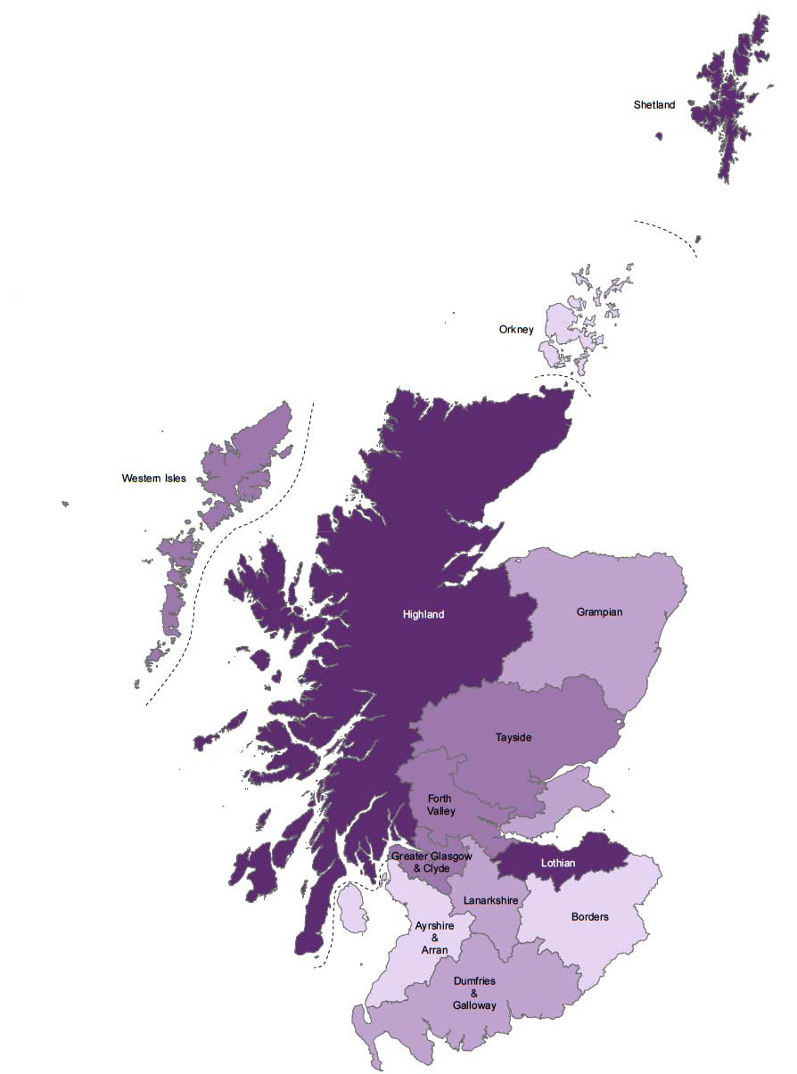
Contact Details – Staff Tutors
Rachel Hitchcock:
rachel.hitchcock@open.ac.uk
NHS Grampian
NHS Orkney
NHS Shetland
Tamsin Smith:
tamsin.smith@open.ac.uk
NHS Highland
NHS Argyll & Bute
NHS Western Isles
Rhona McInnes:
rhona.mcinnes@open.ac.uk
NHS Lothian
NHS Borders
Scotland-Nursing-Applications@open.ac.uk
NHS Greater Glasgow & Clyde
Fiona Ewart:
fiona.ewart@open.ac.uk
NHS Dumfries & Galloway
NHS Fife
NHS Forth Valley
NHS Lanarkshire
NHS State Hospital
NHS Tayside
Lyndsey Blake:
lyndsey.blake@open.ac.uk
NHS 24
NHS Golden Jubilee
NHS Ayrshire & Arran

